Slide 1
Pay Gap REPORT
2024
Data snapshot as of 05/04/2024

Slide 2
Introduction & definitions
This report is a snapshot from 5th April 2024
Definition
A Pay Gap is calculated as the difference between average hourly pay (excluding overtime) of two groups. In line with developing best practice and our diversity, equity, inclusion and belonging (DEIB) strategy, we are monitoring and reporting pay gaps for all diversity groups: Gender, Ethnicity, Sexual Orientation, Disability, Age and Faith & Belief. For reference, Equal Pay means different groups doing the same work, or work of equal value, must be paid the same.
Values
We observe two % values:
Median (often referred to as Midpoint).
  This is the middle value of all hourly pay rates when they are arranged in ascending order. It means that half of the employees earn less than this amount and the other half earn more. It is shown as the % difference for the entire group. For example, if the Median of pay for Males is £20 and for Females it is £18, the Median pay gap is 10%, as this is how much more Males earn than Females. The Median is often considered a better indicator than the Mean (Average) because it is less affected by extremely high or low pay rates.
Mean (often referred to as Average).
  This is the % average difference in hourly pay between two groups (e.g. Male to Female and one earning a % more or less than the other).
Quartile Bands
  We evenly split all staff into four quartiles, then look at how each measured group is distributed across those quartiles. This helps us understand what proportion of each group that fall into different hourly earnings. The Quartiles Bands are:
    A (lowest paid roles), B (low-mid paid roles), C (mid-high paid roles), D (highest paid roles).
Our commitment to DEIB
We are committed to listening and engaging with our colleagues on issues which might impact our pay gaps and continue to have spaces for discussions around DEIB. In our most recent workforce survey (November 2024), the results show:
81% of colleagues agree that diversity of views, opinions, skills and identities are genuinely valued at Young Lives vs Cancer
81% of colleagues agree they saw evidence of progress in our work to improve diversity, equity, inclusion and belonging
Our commitment to a DEIB strategy is a factor in our ability to close the Median and Mean pay gaps between groups.
2

Slide 3
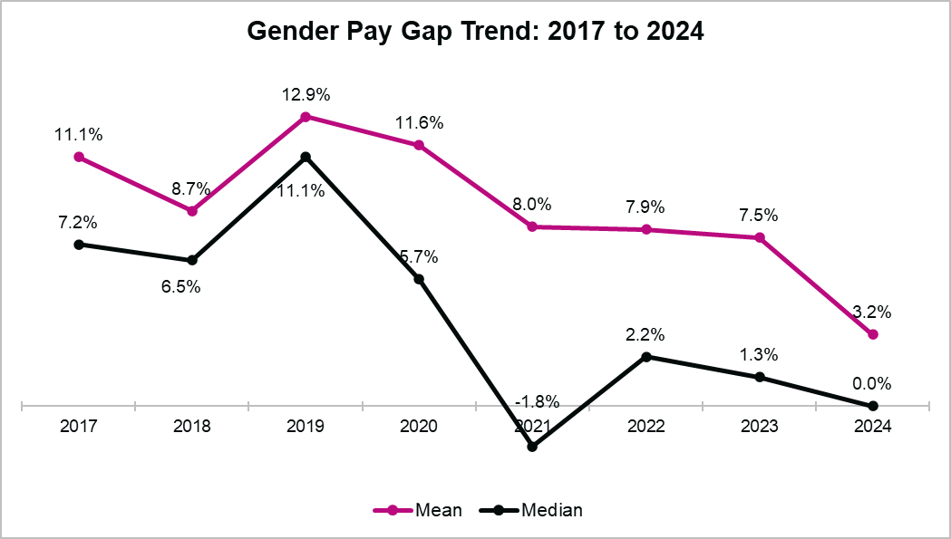
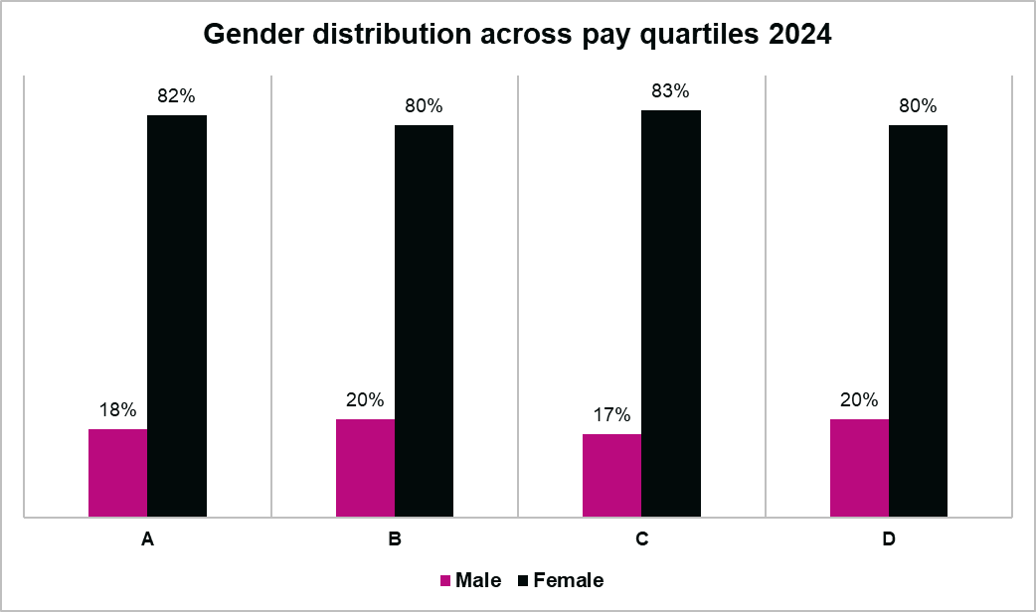
Gender Pay Gap
On 5th April 2024, YLvC’s workforce was made up of 18% Men and 82% Women (proportionately the same as of April 2023).
Gender Median and Mean earnings
The Median gender pay gap is 0.0% (down from 1.3% in April 2023).
  This is significantly lower than the UK gender pay gap of 13.1%.
It shows that at YLvC there’s no difference in pay for Men and Women at the Median point of earnings.
However, at the Mean, Men earn 3.2% more than Women (down from 7.5% in April 2023). This shows the gap between average earnings is closing.
Gender Pay Quartiles
The gender split across pay quartiles is almost identical to that of our total workforce.
Compared to last year, the proportion of Women in the lowest paid roles (Band A) has fallen by 4% and increased by 4% in higher paid roles (Band D).
In B and D, the Median identifies that Men earn 1.0% more than Women (a fall from 6.9% in April 2023) and at the Mean, Men earn 3.1% more (down from 8% in April 2023). This shows that the Gender pay gap is closing.
In Band A, at the Median, Women earn 1.3.% more than Men, but their Mean earnings are 1.9% less.
(Band A = lowest pay quartile; Band D = highest pay quartile)

Slide 4
Gender Pay Gap
Gender Further Analysis
Males make up 18% of YLvC’s workforce and across each job grade, their representation is within 5% of this figure. The exceptions are Senior Practitioner (where they represent 29.41%), Administrator (23.81%), Co-ordinator (12.5%), Director (28.57%).
The pay gap between Males and Females is narrow across almost all job grades. In the lowest paid grade (Retail), the pay gap favours Females, earning 15.9% more than Males at the Median and 10% more than Males at the Mean.
However, at Director level (excluding CEO), the Mean pay for Males is 12.2% higher than Females (down slightly from 12.7% in April 2023). The Median pay shows that Males earn 3.2% more than Females (a drop from 9% in April 2023). At the time of analysis, 28.57% (2 out of 7) of the Directors were Male (down from 43% in April 2023).
  However, it should be reiterated that the Gender Pay Gap looks at average hourly pay. As part of the calculation, salary sacrifices (e.g. pension, childcare vouchers, annual leave purchases and more) are deducted from gross pay. At YLvC, salary sacrifice uptake is higher from Females, with almost half purchasing additional annual leave and a quarter utilising Health Cash Plan and Childcare Vouchers. The largest salary sacrifice difference is highest when observing Pension contributions. On average, Females sacrifice 14% of their salary for Pensions compared to 4% of Males.
At Associate Director level, Mean earnings of Males are 17.3% higher than Women (up from 9.5% in April 2023). At the Median, Males earn 16.5% more than Females (up from 10.5% in April 2023). Further context must be given, as 7 of the 8 Associate Directors are Female (now 88%, up from 85% in April 2023). With a higher proportion of Females, there’s a wider range of Female salaries, compared to only one Male.
  As with Director level, we see the influence of salary sacrifices on pay. Although Male earnings are higher at this level, Females make greater pension contributions, have purchased Annual Leave and Childcare Vouchers.

Slide 5
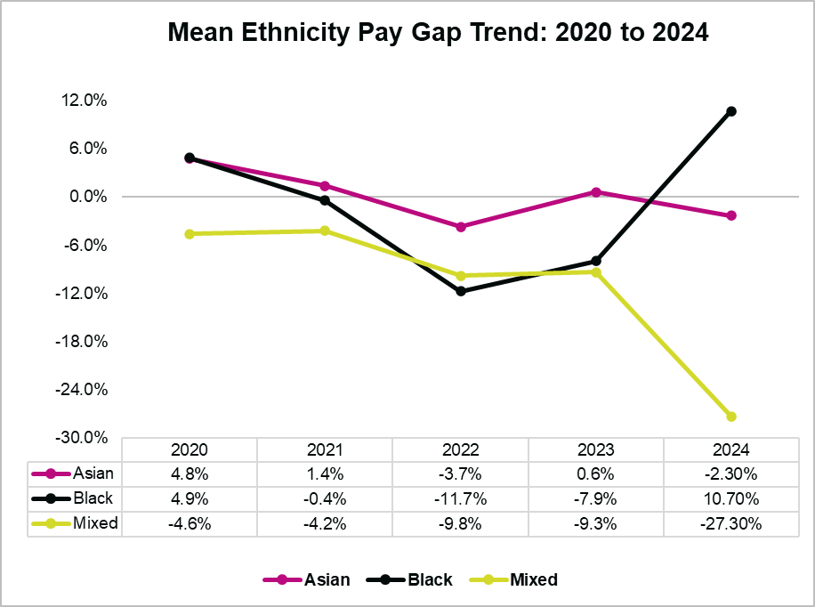
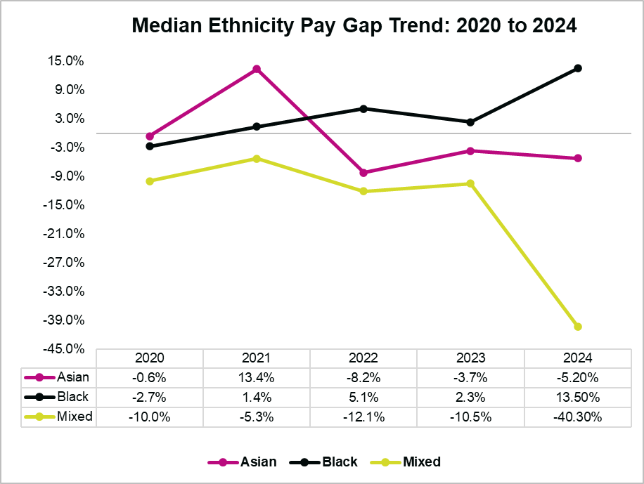
ETHNICITY Pay Gap
Staff from Asian, Black and Mixed ethnicity groups represent 8.21% of the YLvC workforce (down from 9% in April 2023).
The Ethnicity pay gap shows the difference between Asian, Black and Mixed ethnicity groups compared to the White ethnic group.
As a proportion of YLVC’s workforce, the Ethnicity breakdown is Asian 3.44%, Black 2.65%, Mixed 2.12%. Note that 4.23% of people chose not to disclose their Ethnicity. Small changes to any group could have a big impact on figures. Combined with a small demographic size, this makes it difficult to suggest Ethnicity has a significant impact on pay gaps. However, it is useful to observe patterns which could lead to further investigation.
Ethnicity Median and Mean earnings
In the charts below, a negative figure shows an inverse pay gap. This means the group earns more than the White Ethnic group.
There are large swings in the Mean pay gap for Black ethnicity employees. At the Mean, they now earn 10.7% less (previously earning 7.9% more in April 2023) than White Ethnicity and at the Median, 13.3% less (previously 2.3% less in April 2023).
Mixed Ethnicity employees show an opposite trend and at the Mean are now paid 27.3% more than White Ethnic (previously 9.3% more in April 2023) and at the Median 40.3% more (previously 10.5% in April 2023).
Asian Ethnicity employees at the Mean are now paid 2.3% more (it was 0.6% less in April 2023) and at the Median 5.2% more (up from 3.7% in April 2023).
This data shows the gap between Ethnic groups compared to the White Ethnic group has widened.

Slide 6
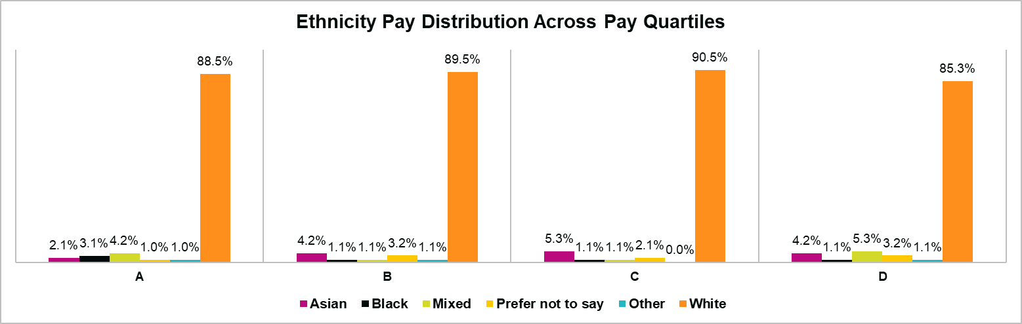
ETHNICITY Pay Gap
Ethnicity Pay Quartiles
The Band with the highest proportion of Asian and Mixed Ethnicity employees is D (highest pay). Band D has the lowest proportion of Black Ethnicity employees, but they are more evenly represented in Bands A-C.
(Band A = lowest pay quartile; Band D = highest pay quartile)
Ethnicity Further Analysis
8.7% of those who took on new positions, redeployments or received increased salary changes in the year were Asian, Black, or Mixed Ethnicity employees. This almost exactly matches their representation as a proportion of the total workforce.

Slide 7
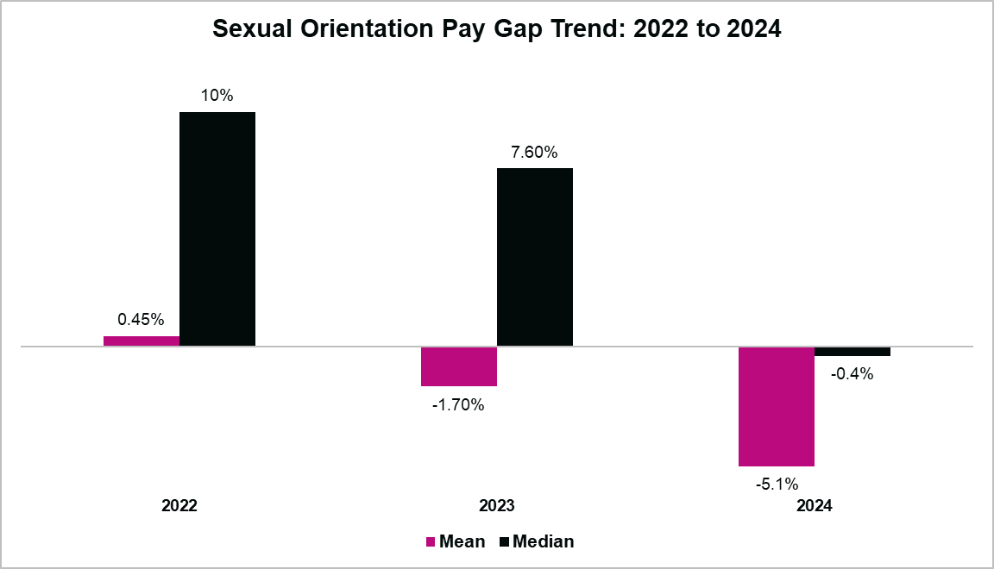
SEXUAL ORIENTATION Pay Gap
As a proportion of the workforce, 8% identify as LGBTQIA+ (up from 6% in April 2023). Those who Prefer Not to Say is 14% (down from 15% in April 2023).
The Sexual Orientation pay gap compares those identifying as Gay/Lesbian or Bi (umbrella term) (in our analysis we group these demographics under the term LGBTQIA+), to those identifying as Heterosexual.
Small changes to any group could have a big impact on figures. These factors combined with a small demographic size make it difficult to suggest Sexual Orientation has a significant impact on pay gaps. However, it is useful to observe patterns which could lead to further investigation.
Sexual Orientation Median and Mean earnings
In the charts below a negative figure shows an inverse pay gap, which means it favours those identifying as LGBTQIA+, as they earn more than those identifying as Heterosexual
At the Mean, people identifying as LGBTQIA+ earn 5.1% more than those identifying as Heterosexual (an inverse gap and up from 1.7% more in April 2023).
The Median shows those identifying as LGBTQIA+ earn 0.4% more than those identifying as Heterosexual (a huge swing from 7.6% less in April 2023), but one which shows pay between the two groups is almost equal.

Slide 8
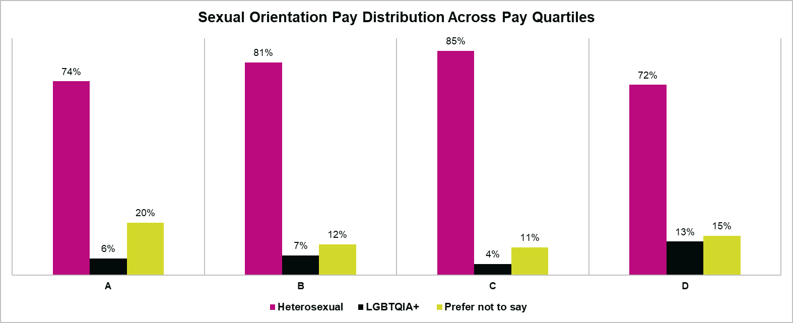
SEXUAL ORIENTATION Pay Gap
Sexual Orientation Pay Quartiles
The proportion of employees identifying as LGBTQIA+ has more than doubled in higher paying roles (in Band D, up to 13% from 5% in April 2023) and declined in lower paying roles (in Band A, down to 6% from 8% in April 2023).
(Band A = lowest pay quartile; Band D = highest pay quartile)
Sexual Orientation Further Analysis
5.26% of those who took on new positions, redeployments or received increased salary changes in the year identify as LGBTQIA+. This is close to their representation in the total workforce (just 1.44% lower).

Slide 9
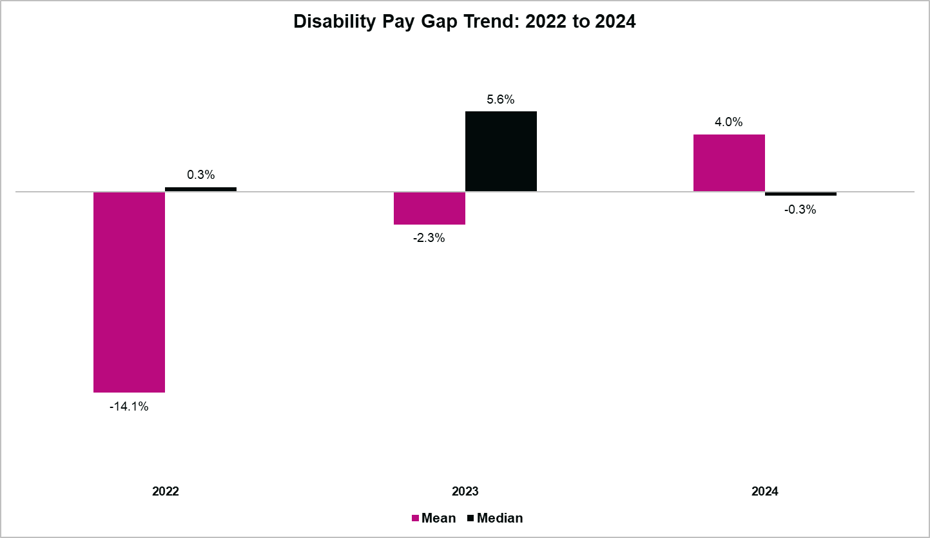
DISABILITY Pay Gap
As a proportion of the workforce, 6.8% have declared a Disability (up from 5% in April 2023).
This looks at the pay gap of those who have declared a Disability compared to those who have no declared Disability.
Small changes to any group could have a big impact on figures. These factors combined with a small demographic size make it difficult to suggest Disability has a significant impact on pay gaps. However, it is useful to observe patterns which could lead to further investigation.
Disability Median and Mean earnings
In the chart below a negative figure shows an inverse pay gap, which means it favours those with a declared Disability, as they earn more than those with no declared Disability.
At the Mean, people with a declared Disability earn 4% less than those with no declared Disability (this is a reverse from April 2023 where they earned 2.3% more). At the Median people with a declared Disability earn 0.3% more than those with no declared Disability This is again a reverse from April 2023, where they earned 5.6% less. It shows that at the Median, pay is almost equal across both groups.

Slide 10
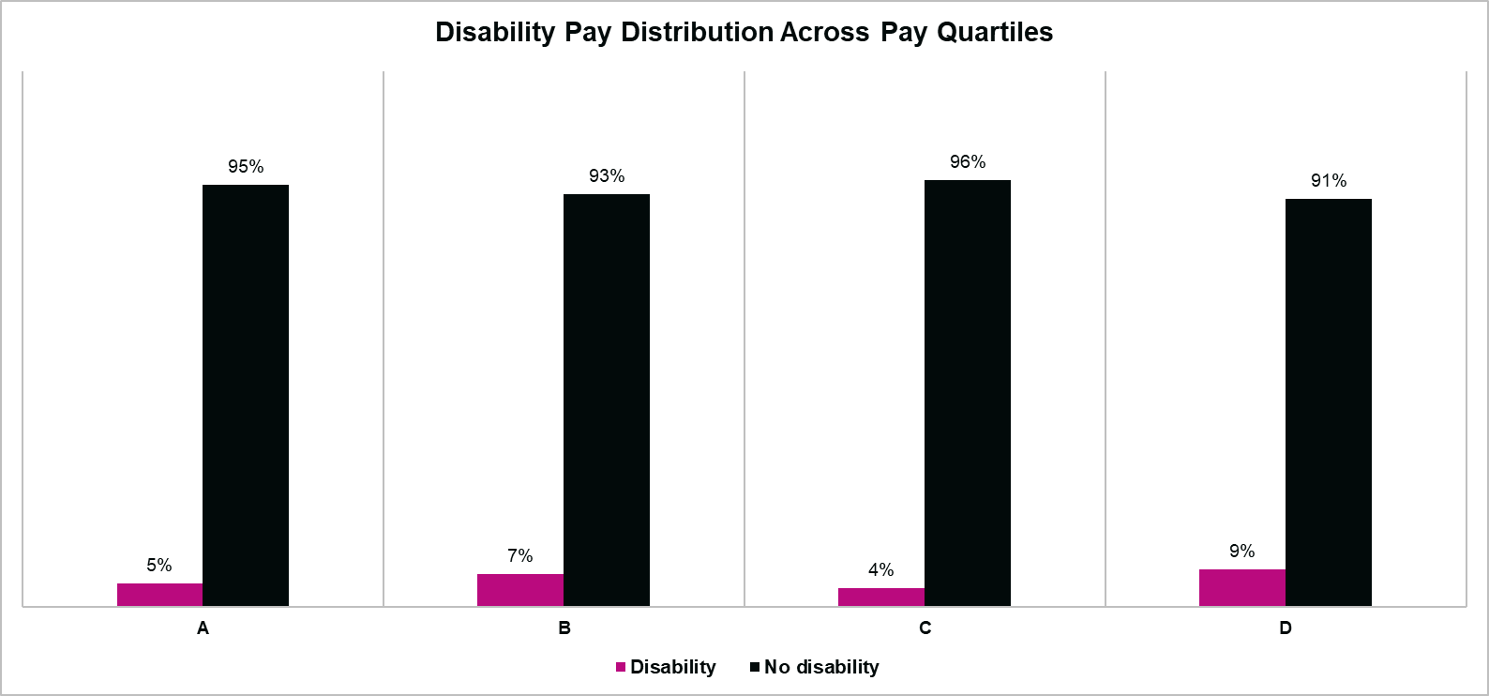
DISABILITY Pay Gap
Disability Pay Quartiles
The proportion of people with a declared Disability in the highest earning quartile (Band D) has more than doubled to 9% (up from 4% in April 2023). Other Bands are almost identical to April 2023.
(Band A = lowest pay quartile; Band D = highest pay quartile)
Disability Further Analysis
12.3% of those who took on new positions, redeployments or received increased salary changes in the year had declared a Disability.
This is higher than their representation as a proportion of the total workforce (7%).

Slide 11
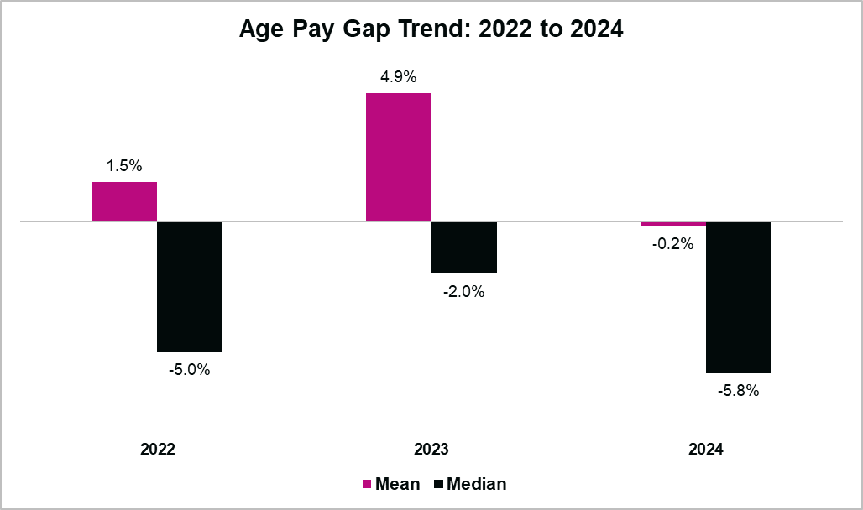
AGE Pay Gap
The population of our workforce is almost equal, with 52% 40 and Under and 48% Over 40 (a reversal from 52% in April 2023).
This measure looks at the Pay Gap of those 40 and Under compared to those Over 40.
Age Median and Mean earnings
In the chart below a negative figure shows an inverse pay gap, which means it favours those 40 and Under, as they earn more than those Over 40.
At the Mean, those 40 and Under earn 0.2% more than those Over 40 (a change from earning 4.9% less in April 2023). The Median shows those 40 and Under earn 6% more than those Over 40 (up from 2% in April 2023).

Slide 12
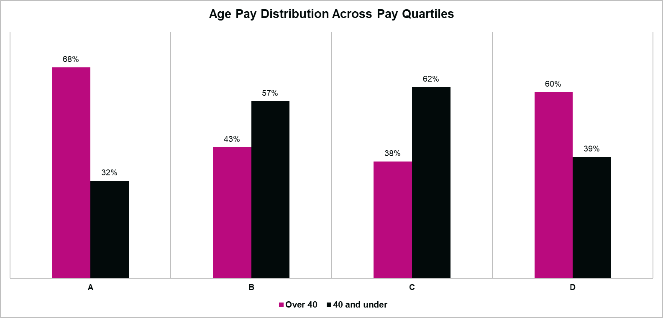
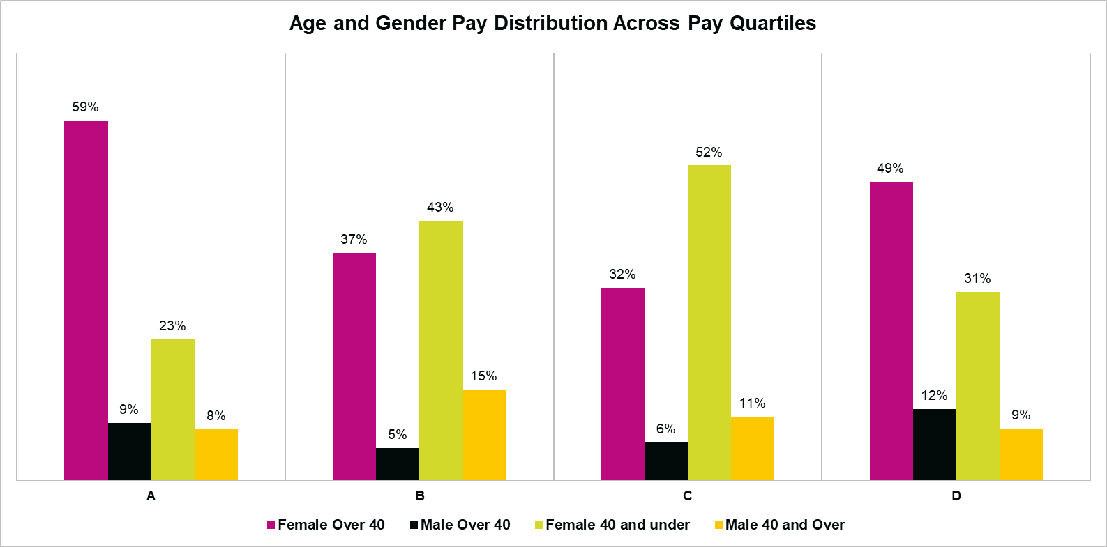
AGE Pay Gap
Age Pay Quartiles
Age and Gender Pay Quartiles
With an almost equal age split, it’s interesting to observe Over 40s represent the largest proportion of both the highest (Band D) and lowest earners (band A). There’s a much higher proportion of 40 and Under in the middle pay bands (Bands B and C).
We see a slight divergence when comparing Age to Gender. 54% of Females are Over 40, but 56% of Males are 40 and Under.
The highest proportion of Females Over 40 are in lower paid positions (59% of Band A). However, they are proportionately the largest in higher paid positions (49% of Band D).
Males Over 40 have their highest representation in higher paid positions (12% of Band D). The largest proportion of males 40 and Under are in the mid to lower paid positions (15% are in Band B).
(Band A = lowest pay quartile; Band D = highest pay quartile)
(Band A = lowest pay quartile; Band D = highest pay quartile)
Age Further Analysis
50.9% of those who took on new positions, redeployments or received increased salary changes are 40 and Under, with 49.1% Over 40.

Slide 13
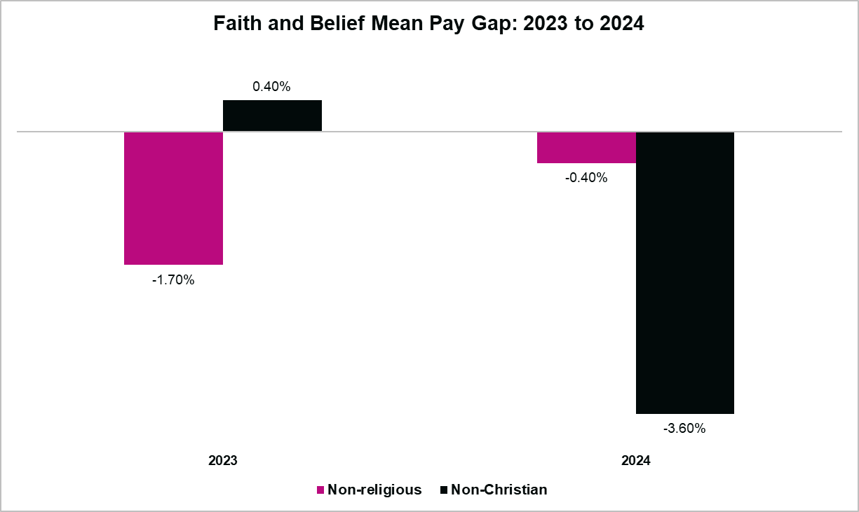
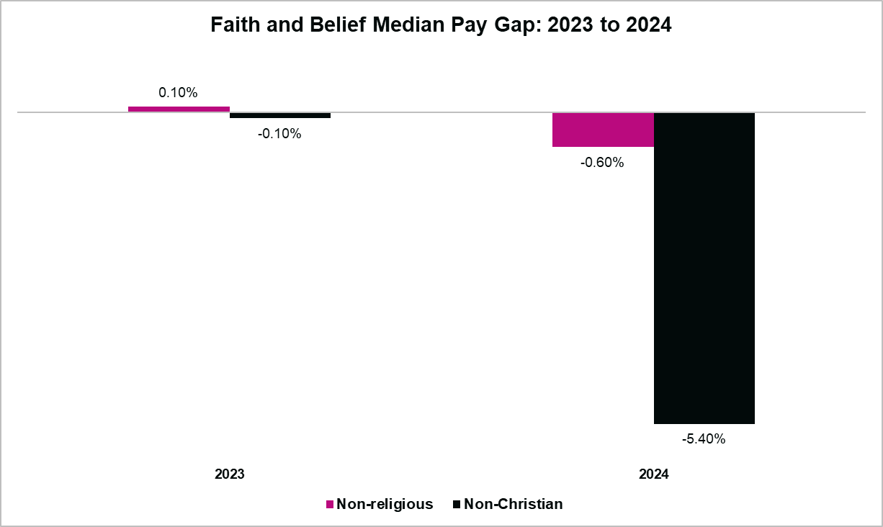
FAITH AND BELIEF Pay Gap
Our data shows that 41% of employees are Non-religious, 5% follow a Non-Christian Faith/Belief, 17% Preferred Not to Say and 37% are Christian.
This looks at the Pay Gap between those who declare they’re Non-Christian or Non-Religious compared to those who declare a Christian religion. We use this comparison because it aligns with Census 2021 data which identified Christian as the majority religion in England and Wales.
Faith and Belief Median and Mean earnings
In the chart below a negative figure shows an inverse pay gap, which means it favours Non-religious or Non-Christian, as they earn more than Christians.
We see a tightening in the Non-religious pay gap, where at the Mean, the group now earn 0.4% more than Christians (previously 1.7% more in April 2023). Also at the Mean, Non-Christians earn 3.6% more than Christians (previously 0.4% less in April 2023).
The Median shows a change for Non-religious employees who earn 0.6% more than Christians. Also at the Median, Non-Christians earn 5.4% more than Christians.

Slide 14
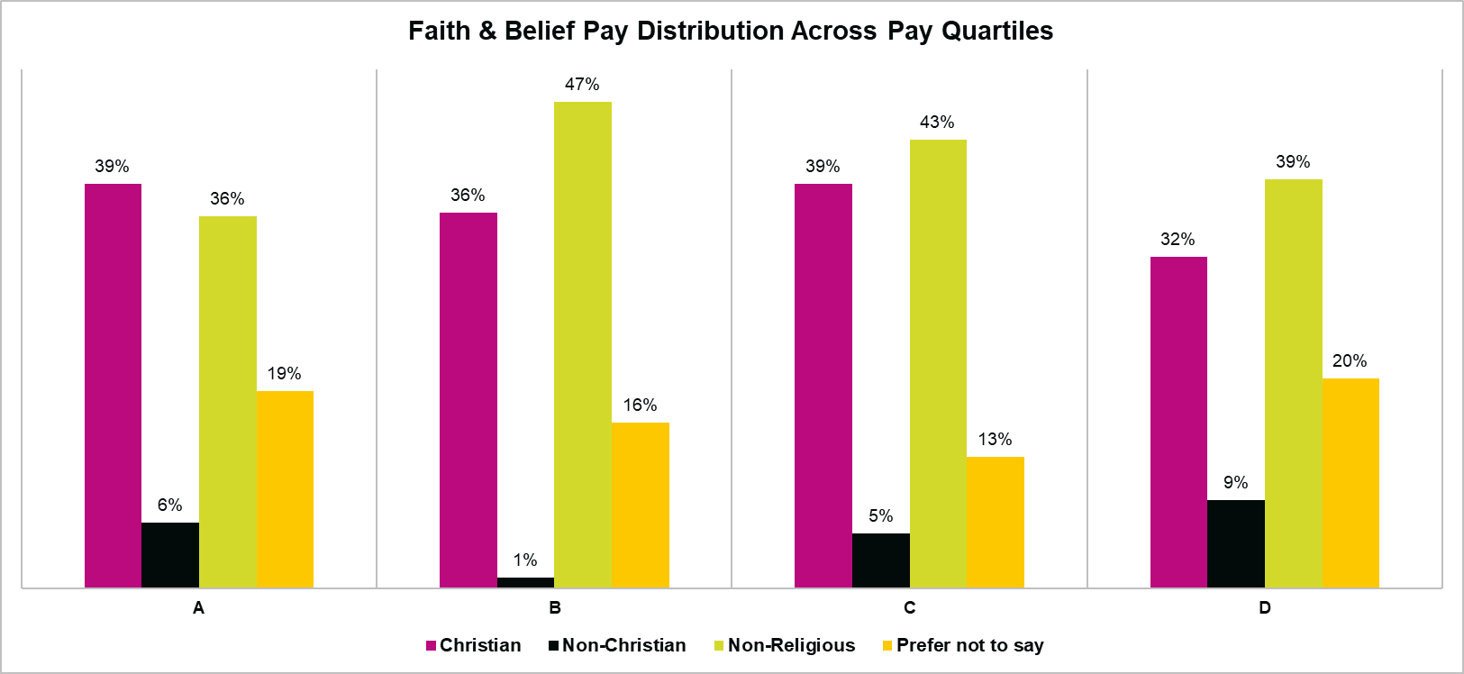
FAITH AND BELIEF Pay Gap
Faith and Belief Pay Quartiles
The balance of Faiths and Beliefs across pay quartiles is reasonably consistent.
(Band A = lowest pay quartile; Band D = highest pay quartile)
Faith and Belief Further Analysis
Of those who took on new positions, redeployments, or received increased salary changes in the year, 3.5% were Non-Christian (who make up 5% of the workforce) and 49.1% were Non-religious (who make up 41% of the workforce).

Slide 15
Next Steps
Actions we are taking in support of addressing our pay gaps
While we are pleased to see reducing pay gaps, we remain committed to the measures that have helped us achieve this.
We are continuing to review our employment policies, conducting equity impact assessments on existing policies to ensure that they do not negatively impact anyone based on their protected characteristic.
We will continue to monitor our recruitment practices to enable us to attract a diverse range of applicants across all protected characteristics
We will continue to monitor our internal movement levels – to understand whether there appears to be any barriers to upward movement for colleagues with protected characteristics.
We will continue to provide progressive and flexible working arrangements across all levels of the organisation as a way of enabling access for all to career development opportunities

