Slide 1
Pay Gap REPORT 2025
Data snapshot as of 05/04/2025

Slide 2
Introduction & definitions
This report is a snapshot from 5th April 2025
Definition
A Pay Gap is calculated as the difference between average hourly pay (excluding overtime) of two groups. In line with developing best practice and our diversity, equity, inclusion and belonging (DEIB) strategy, we are monitoring and reporting pay gaps for all diversity groups: Gender, Ethnicity, Sexual Orientation, Disability, Age and Faith & Belief. For reference, Equal Pay means different groups doing the same work, or work of equal value, must be paid the same.
Values
We observe two % values:
Median (often referred to as Midpoint).
This is the middle value of all hourly pay rates when they are arranged in ascending order. It means that half of the employees earn less than this amount and the other half earn more. It is shown as the % difference for the entire group. For example, if the Median of pay for Males is £20 and for Females it is £18, the Median pay gap is 10%, as this is how much more Males earn than Females. The Median is often considered a better indicator than the Mean (Average) because it is less affected by extremely high or low pay rates.
Mean (often referred to as Average).
This is the % average difference in hourly pay between two groups (e.g. Male to Female and one earning a % more or less than the other).
Quartile Bands
We evenly split all staff into four quartiles, then look at how each measured group is distributed across those quartiles. This helps us understand what proportion of each group that fall into different hourly earnings. The Quartiles Bands are:
A (lowest paid roles), B (low-mid paid roles), C (mid-high paid roles), D (highest paid roles).
Our commitment to DEIB
We are committed to listening and engaging with our colleagues on issues which might impact our pay gaps and continue to have spaces for discussions around DEIB. In our most recent workforce survey (November 2024), the results show:
81% of colleagues agree that diversity of views, opinions, skills and identities are genuinely valued at Young Lives vs Cancer
81% of colleagues agree they saw evidence of progress in our work to improve diversity, equity, inclusion and belonging
Our commitment to a DEIB strategy is a factor in our ability to close the Median and Mean pay gaps between groups.
2

Slide 3
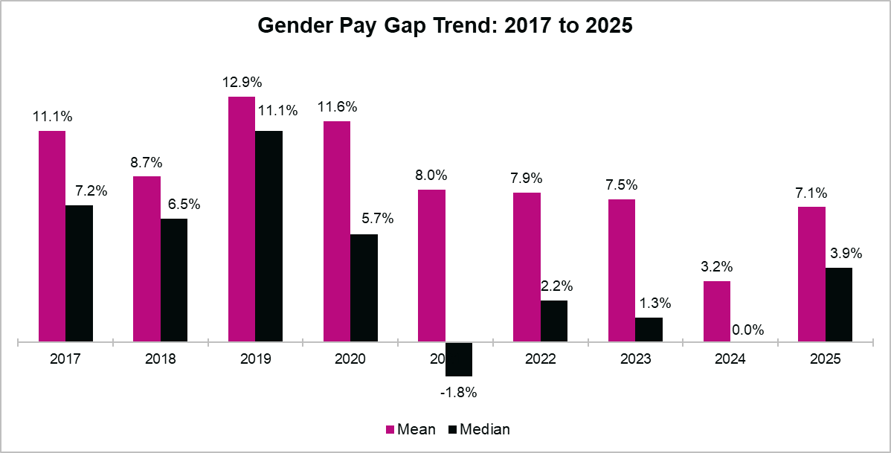
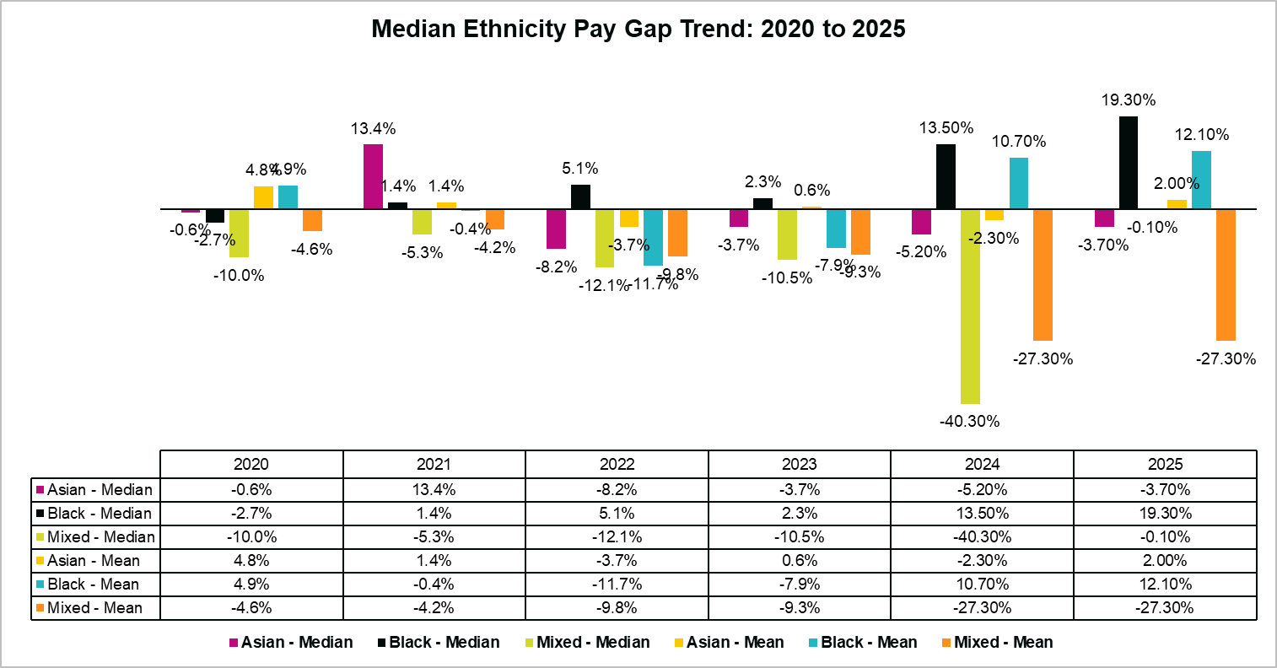
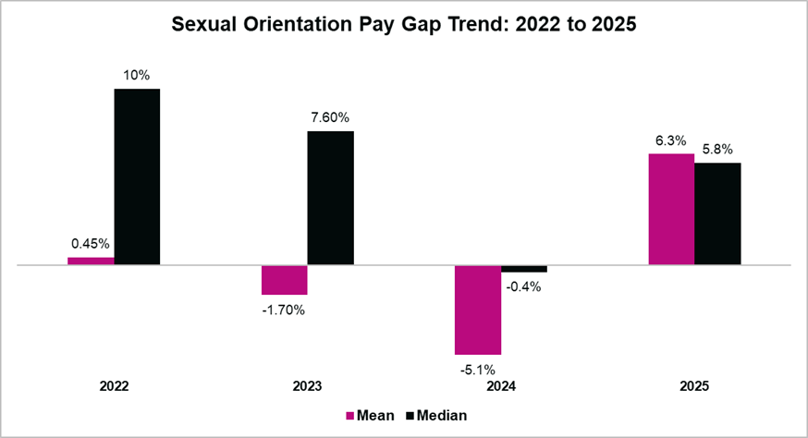
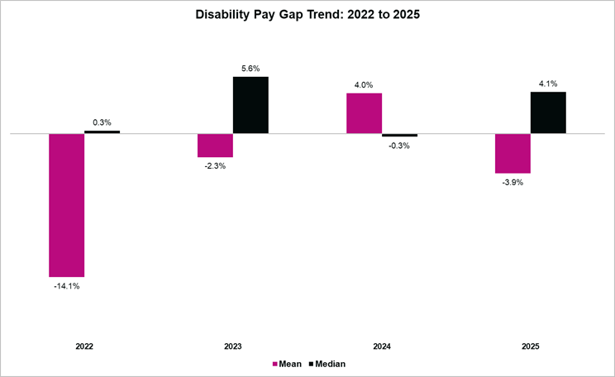
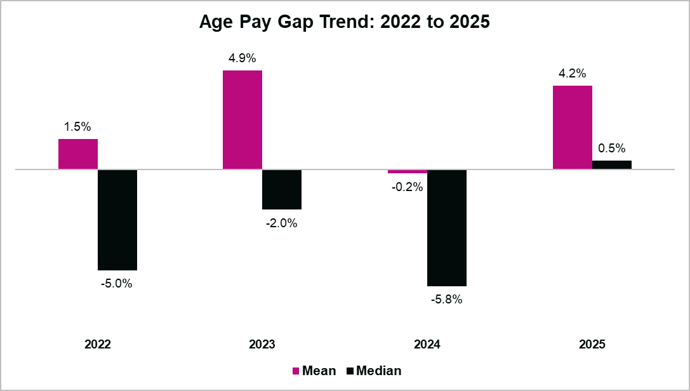
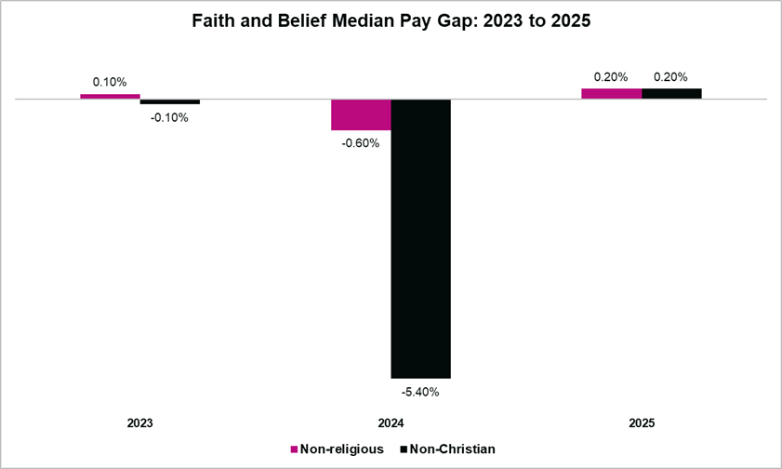
The data in each chart goes back as far as we have records. Timelines vary due to the periods we started measuring each metric.
HEADLINE SUMMARY OF 2025 PAY GAPs
The Median Gender pay gap is 3.9% (up from 0% in April 2024), which means at YLvC, Males earn 3.9% more than Females at the middle point of earnings. Compared to last year, this shows a widening pay gap.
At the Median, people of Asian ethnicity earn 3.7% more than people of White ethnicity (down from 5.2% in 2024). People of Black ethnicity earn 19.3% less than people of White ethnicity (widening from 13.5% in April 2024). People of mixed ethnicity see a narrowing gap, now earning 0.10% more than people of White ethnicity (down from 40.30% more in April 2024). Overall, compared to last year, there is a narrowing pay gap.
The Median shows those identifying as LGBTQIA+ earn 5.8% less than those identifying as Heterosexual (a reversal from earning 0.4% more in April 2024). Compared to last year, this shows a widening pay gap.
At the Median people with a declared Disability earn 4.1% less than those with no declared Disability This is a reversal from April 2024, where they earned 0.3% more. Compared to last year, this shows a widening pay gap.
At the Median, those 40 and Under earn 0.5% less than those Over 40 (down from 5.8% more in April 2024). Compared to last year, this shows a narrowing pay gap.
The Median shows a change for Non-religious and Non-Christians, both now earning 0.20% less than Christians. Compared to last year, this shows a narrowing pay gap.
3

Slide 4
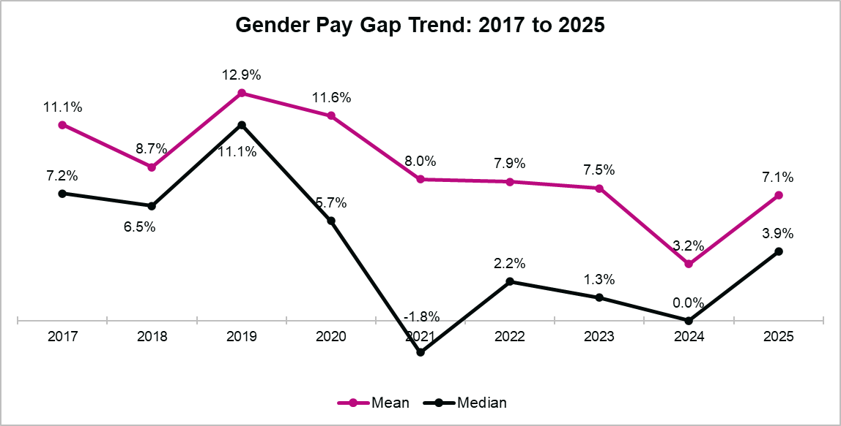
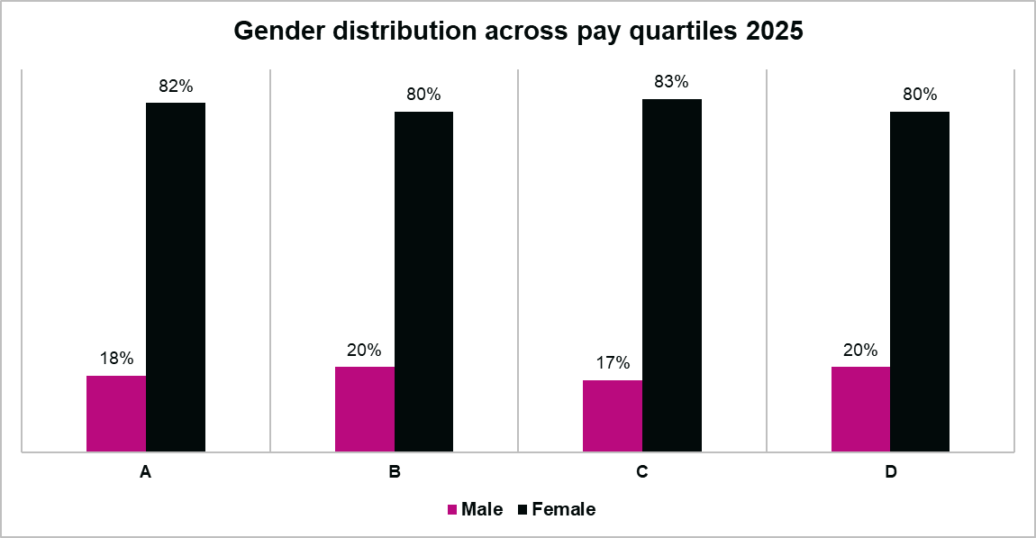
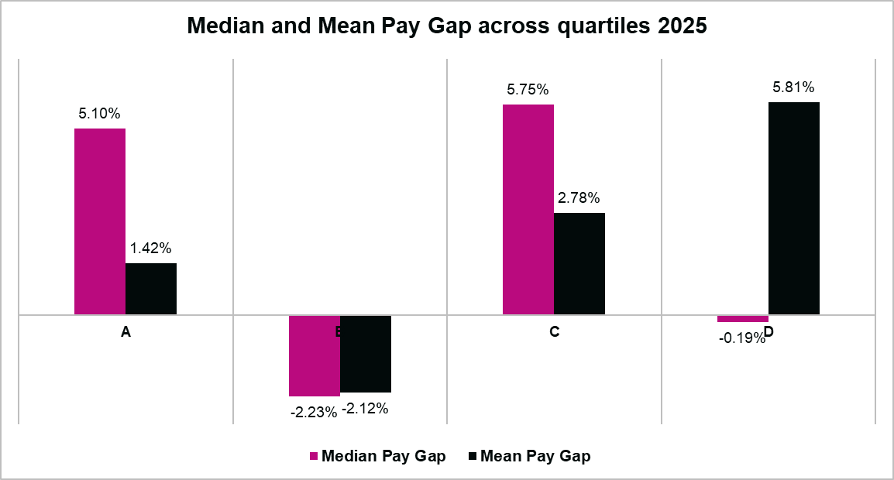
Gender Pay Gap
On 5th April 2025, YLvC’s workforce was made up of 18% Male and 82% Female (proportionately the same as of April 2024).
Gender Median and Mean earnings
The Median gender pay gap is 3.9% (up from 0% in April 2024), which means at YLvC, Males earn 3.9% more than Females at the middle point of earnings.
This is significantly lower than the UK gender pay gap of 13.1%.
At the Mean, Males earn 7.1% more than Females (up from 3.2% in April 2024). It shows the gap between average earnings has increased.
Reflecting on trends, the Median is at its highest since 2020, but lower than the years prior to that. After a fall in 2024, the Mean has returned to a similar post-2020 historic level. Both the Median and Mean are at lower historic levels than pre-2021.
(Band A = lowest pay quartile; Band D = highest pay quartile)
(Band A = lowest pay quartile; Band D = highest pay quartile)
Gender Pay Quartiles
The gender split across pay quartiles is almost identical to that of our total workforce (18% Males, 20% Females).
Compared to 2024, the proportion of Females in the lowest (Band A) and highest (Band D) paid roles has fallen by 1% and 3% respectively. Females have increased in the lower middle (Band B) and upper middle (Band C) roles, by 7% and 1% respectively.
The Median Pay Gap identifies Males earn more in bands A and C, but less in bands B and D. However, it is only 0.19% less in band D, showing very little difference in Median earnings at the higher levels of pay and thus a very tight pay gap.
However, at band D, we also see the highest gap in Mean earnings, which are 5.81% higher for Males.

Slide 5
Gender Pay Gap
Gender Further Analysis
Males represent 18% of YLvC’s workforce. Their highest proportional representation is at Director level (42.85%). Conversely, Director level has the lowest proportional representation of Females (57%), whereas they make up 82% of the overall workforce.
The pay gap between Males and Females across all job grades is within 5%, apart from Associate Director and Director levels where we see a much wider divergence.
At Director level (excluding CEO), the Median pay for Males is 15.57% higher than Females (up from 3.2% in April 2024). The Mean pay identifies Males earn 24.10% more than Females (an increase from 12.20% in April 2024). At the time of analysis, 42.85% (3 out of 7) of the Directors were Male (up from 28.57% in April 2024).
However, it should be reiterated that the Gender Pay Gap looks at average hourly pay. As part of the calculation, salary sacrifices (e.g. pension, childcare vouchers, annual leave purchases and more) are deducted from gross pay. At Director level, salary sacrifice uptake is higher from Females, with half purchasing additional annual leave and others purchasing Childcare Vouchers or taking part in Charitable Giving. The largest salary sacrifice difference is highest when observing Pension contributions. On average, Females sacrifice 22% of their salary for Pensions compared to 6% of Males. All these factors combined affects the gender pay gap.
At Associate Director level, the Median pay for Males is 16.8% higher than Females (little change from 16.5% in April 2024). Mean Male earnings are 16.48% higher than Women’s (down from 17.3% in April 2024). Further context must be given, as 8 of the 9 Associate Directors are Female (88%, the same as in April 2024). With a higher proportion of Females, there’s a wider range of Female salaries, compared to only one Male.
As with Director level, we see the influence of salary sacrifices on pay. Although Male earnings are higher at this level, Females make greater pension contributions and have purchased additional Annual Leave, both of which widen the gap.

Slide 6
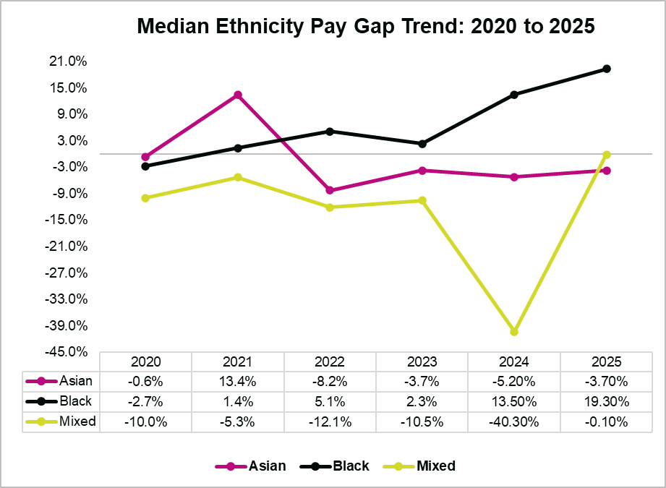
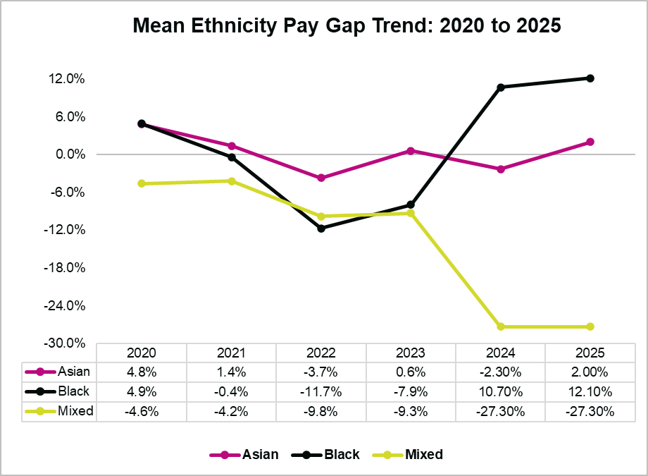
ETHNICITY Pay Gap
Staff from Asian, Black and Mixed ethnicity groups represent 8.38% of the YLvC workforce (up from 8.21% in April 2024).
The Ethnicity pay gap shows the difference between Asian, Black and Mixed ethnicity groups compared to the White ethnic group.
As a proportion of YLVC’s workforce, the Ethnicity breakdown is Asian 3.93%, Black 1.57%, Mixed 2.88%. Note that 2.36% of people chose not to disclose their Ethnicity. Small changes to any group could have a big impact on figures. Combined with a small demographic size, this makes it difficult to suggest Ethnicity has a significant impact on pay gaps. However, it is useful to observe patterns which could lead to further investigation.
Ethnicity Median and Mean earnings
In the charts below, a negative figure shows an inverse pay gap. This means the group earns more than the White Ethnic group.
At the Median, Black ethnicity employees earn 19.3% less (widening from 13.5% in April 2024). A
At the Mean we see little change, apart from Asian ethnicity who now earn 2% less (was 2.3% more in April 2024).
Overall, the data shows that the pay gap between Minoritised Ethnic Communities compared to the White Ethnic group has decreased.

Slide 7
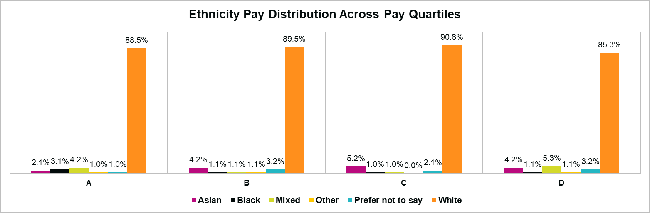
ETHNICITY Pay Gap
Ethnicity Pay Quartiles
The Band with the highest proportion of Asian and Mixed Ethnicity employees is D (highest pay) where they represent 10.5%.
(Band A = lowest pay quartile; Band D = highest pay quartile)
Ethnicity Further Analysis
12.5% of those who took on new positions, redeployments or who had changes to pay in the year were Asian, Black, or Mixed Ethnicity employees. This is 4.12% higher than their representation as a proportion of the total workforce.

Slide 8

SEXUAL ORIENTATION Pay Gap
As a proportion of the workforce, 9.16% identify as LGBTQIA+ (up from 8% in April 2024). Those who Prefer Not to Say is 11.78% (down from 14% in April 2024).
The Sexual Orientation pay gap compares those identifying as Gay/Lesbian or Bi (umbrella term) (in our analysis we group these demographics under the term LGBTQIA+), to those identifying as Heterosexual.
Small changes to any group could have a big impact on figures. These factors combined with a small demographic size make it difficult to suggest Sexual Orientation has a significant impact on pay gaps. However, it is useful to observe patterns which could lead to further investigation.
Sexual Orientation Median and Mean earnings
In the charts below a positive figure shows a pay gap, meaning Heterosexual employees earn more than those identifying as LGBTQIA+.
The Median shows those identifying as LGBTQIA+ earn 5.8% less than those identifying as Heterosexual (a reversal from earning 0.4% more in April 2024).
At the Mean, people identifying as LGBTQIA+ earn 6.3% less than those identifying as Heterosexual (a reversal from 5.1% more in April 2024).
Overall, this shows a widening pay gap between LGBTQIA+ identifying and Heterosexual employees.

Slide 9
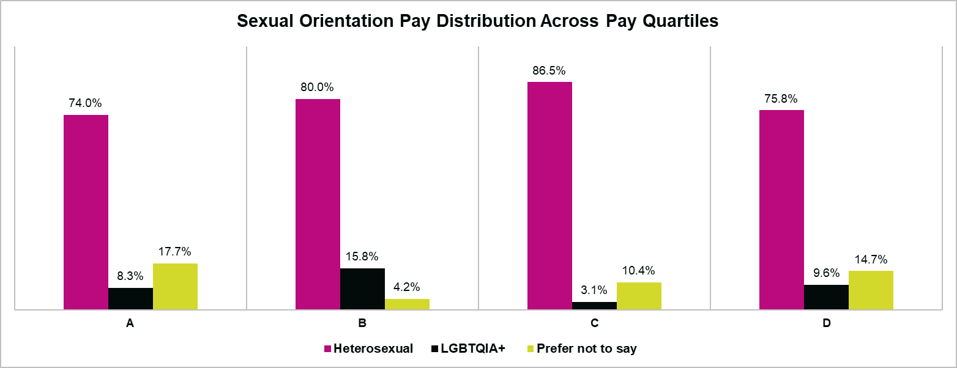
SEXUAL ORIENTATION Pay Gap
Sexual Orientation Pay Quartiles
The proportion of employees identifying as LGBTQIA+ has fallen in higher paying roles and increased in lower paying roles. (Compared to April 2024, Band A is up 2.3%, Band B is up 8.8%, Band C is down 0.9%, Band D is down 3.4%).
(Band A = lowest pay quartile; Band D = highest pay quartile)
Sexual Orientation Further Analysis
14.28% of those who took on new positions, redeployments or who had changes to pay in the year identify as LGBTQIA+. This is above their representation in the total workforce (which is 9.16%).

Slide 10

DISABILITY Pay Gap
As a proportion of the workforce, 10.2% have declared a Disability (up from 6.8% in April 2024). Increased disclosure across several characteristics reflects growing colleague confidence in sharing personal data, which in turn allows for more accurate and meaningful analysis
This looks at the pay gap of those who have declared a Disability compared to those who have no declared Disability.
Small changes to any group could have a big impact on figures. These factors combined with a small demographic size make it difficult to suggest Disability has a significant impact on pay gaps. However, it is useful to observe patterns which could lead to further investigation.
Disability Median and Mean earnings
In the chart below a negative figure shows an inverse pay gap, which means it favours those with a declared Disability, as they earn more than those with no declared Disability.
At the Median people with a declared Disability earn 4.1% less than those with no declared Disability This is a reversal from April 2024, where they earned 0.3% more. At the Mean, people with a declared Disability earn 3.9% more than those with no declared Disability (again, this is a reversal from April 2024 where they earned 4% less).
Overall, compared to April 2024, it shows a slightly wider pay gap between the two groups.

Slide 11
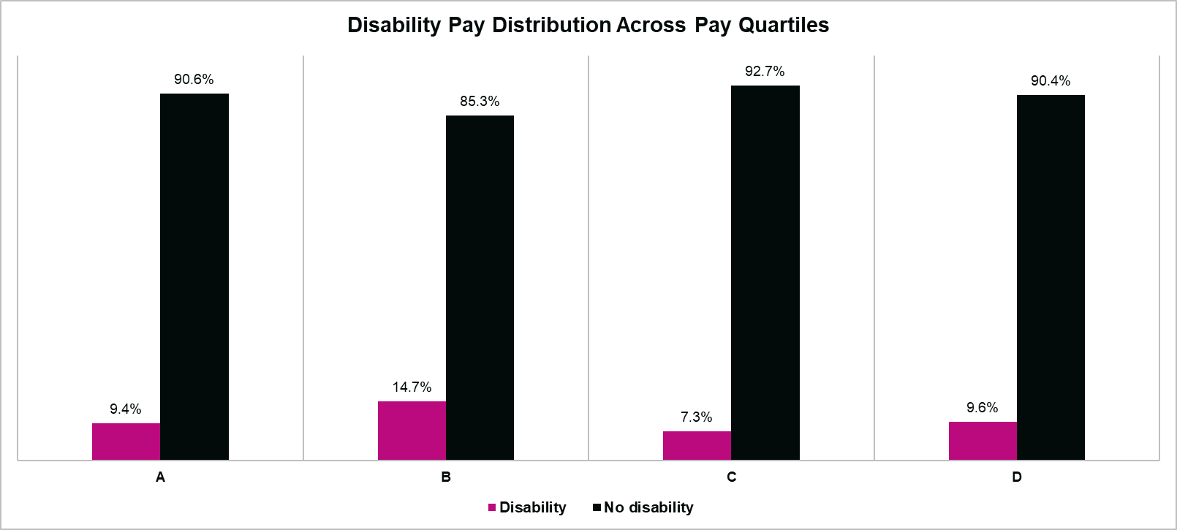
DISABILITY Pay Gap
Disability Pay Quartiles
The proportion of people with a declared Disability has risen in all pay quartiles. (Compared to April 2024, Band A is up 4.4%, Band B is up 7.7%, Band C is up 3.3%, Band D is up 0.5%).
(Band A = lowest pay quartile; Band D = highest pay quartile)
Disability Further Analysis
8.92% of those who took on new positions, redeployments, or who had changes to pay in the year had declared a Disability. This is slightly less than their representation as a proportion of the total workforce (10.2%).

Slide 12

AGE Pay Gap
The population of our workforce is almost equal, with 47.12% aged 40 and Under and 52.88% Over 40 (a reversal from 48% in April 2023).
This measure looks at the Pay Gap of those 40 and Under compared to those Over 40.
Age Median and Mean earnings
In the chart below a negative figure shows an inverse pay gap, which means it favours those 40 and Under, as they earn more than those Over 40.
At the Median, those 40 and Under earn 0.5% less than those Over 40 (down from 5.8% more in April 2024). This shows a narrowing of the pay gap.
At the Mean, those 40 and Under earn 4.2% less than those Over 40 (a change from earning 0.2% more in April 2024).

Slide 13
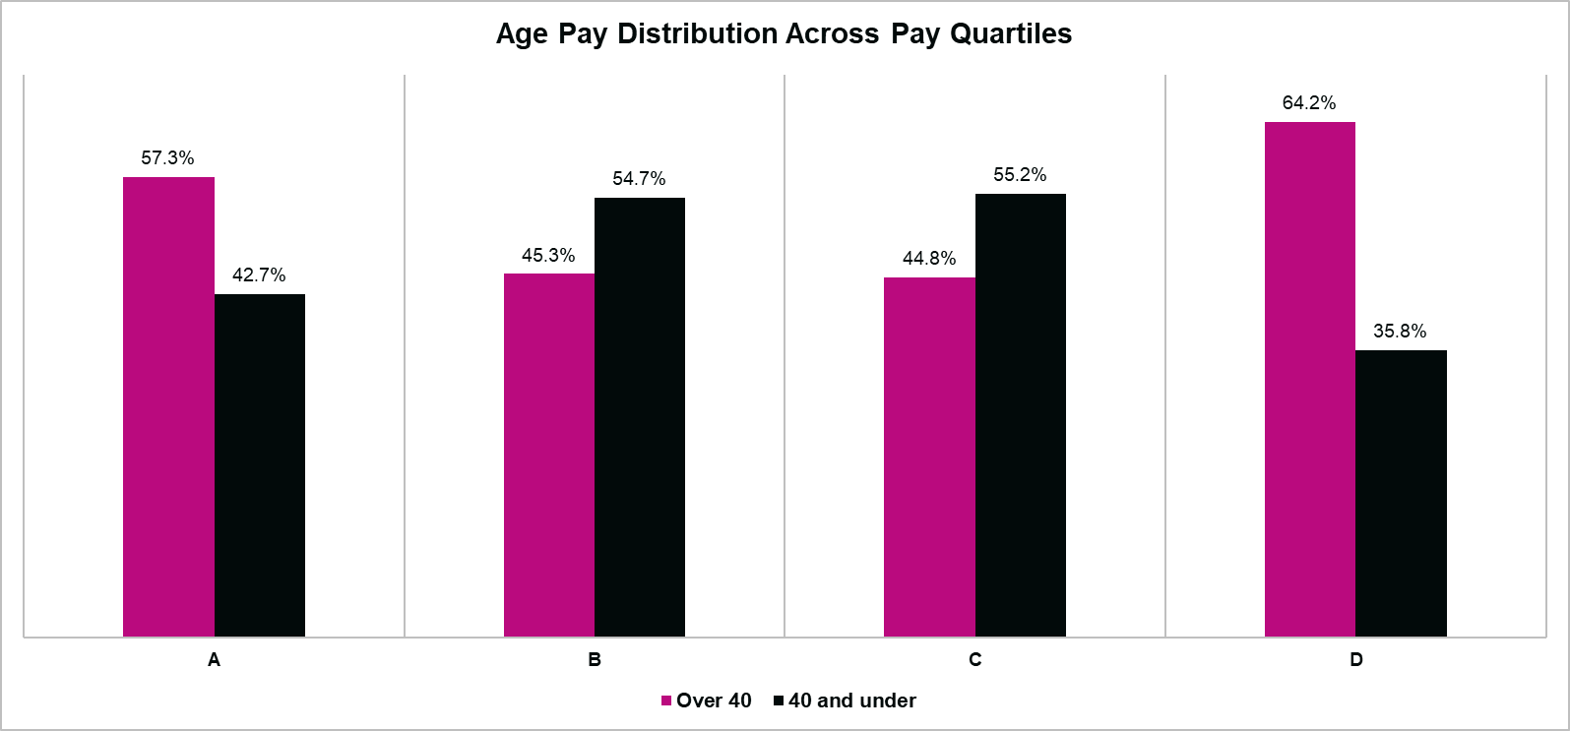
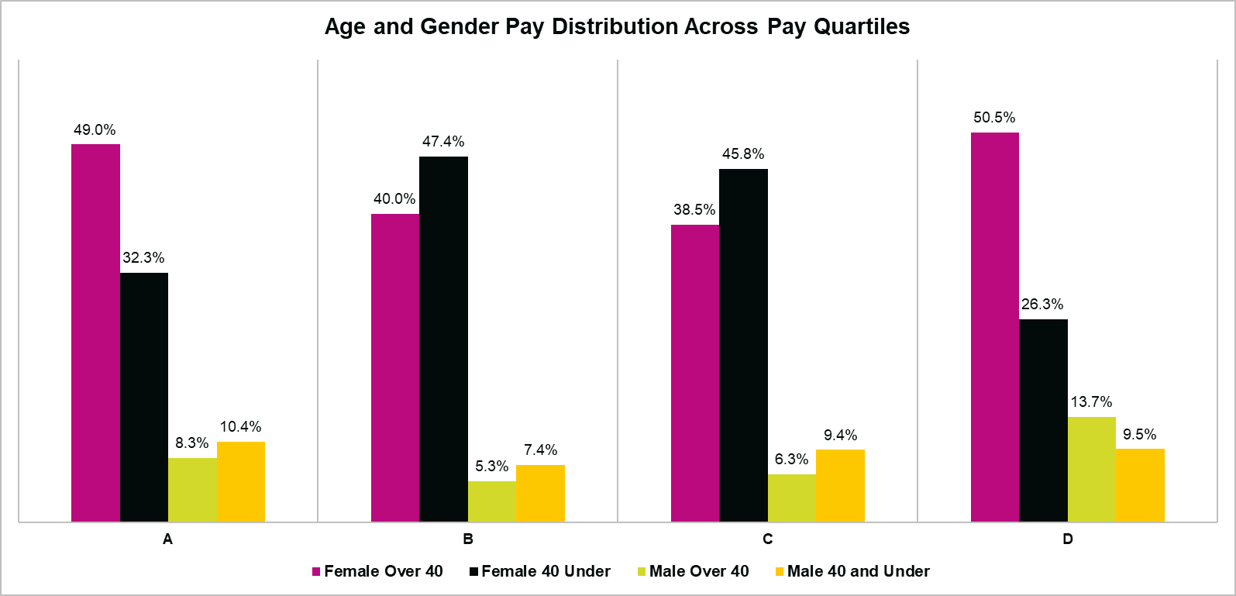
AGE Pay Gap
Age Pay Quartiles
Age and Gender Pay Quartiles
With an almost equal age split, this data shows that Over 40s represent the largest proportion of both the highest (Band D) and lowest earners (band A). There’s a much higher proportion of 40 and Under in the middle pay bands (Bands B and C).
We see a slight divergence when comparing Age to Gender. 54% of Females are Over 40, but 47.76 of Males are Over 40.
The highest proportion of Females Over 40 are in higher paid (50.5% of Band D) and lower paid positions (49% of Band A).
Males Over 40 have their highest representation in higher paid positions (13.7% of Band D). The largest proportion of males 40 and Under are in lower paid positions (10.4% in Band A), but there’s a reasonably even split across all bands.
(Band A = lowest pay quartile; Band D = highest pay quartile)
(Band A = lowest pay quartile; Band D = highest pay quartile)
Age Further Analysis
39.28% of those who took on new positions, redeployments or who had changes to pay in the year are Over 40, with 60.72% Under 40.

Slide 14
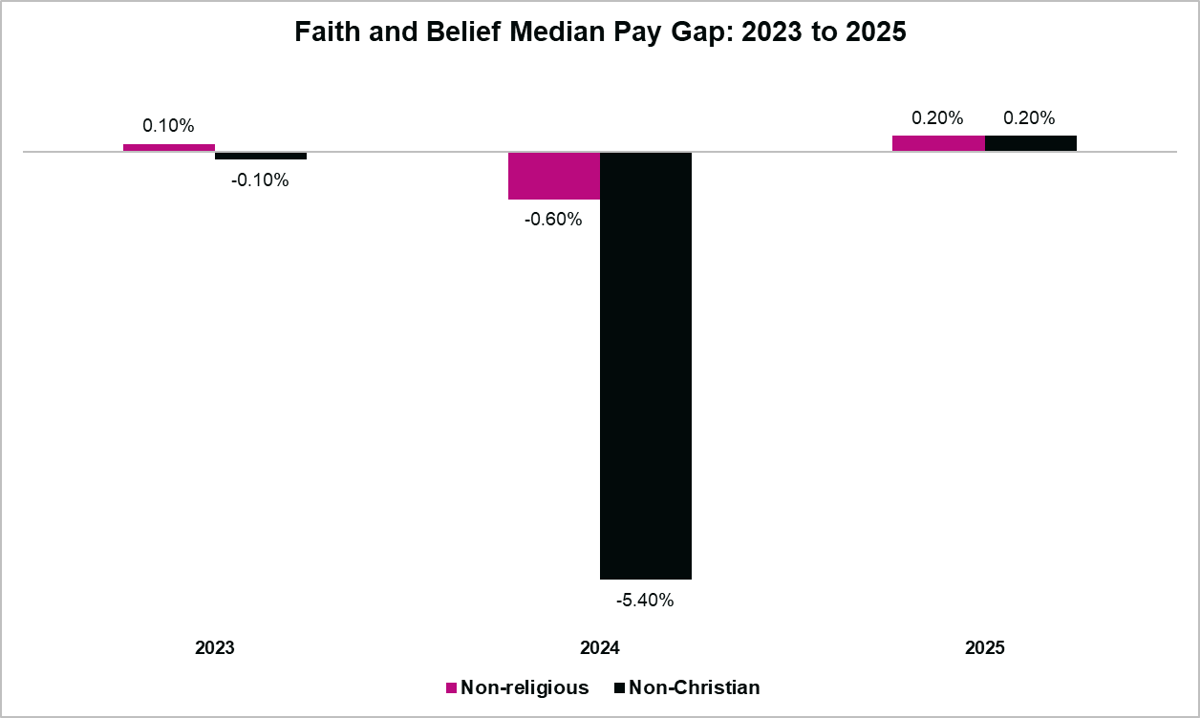
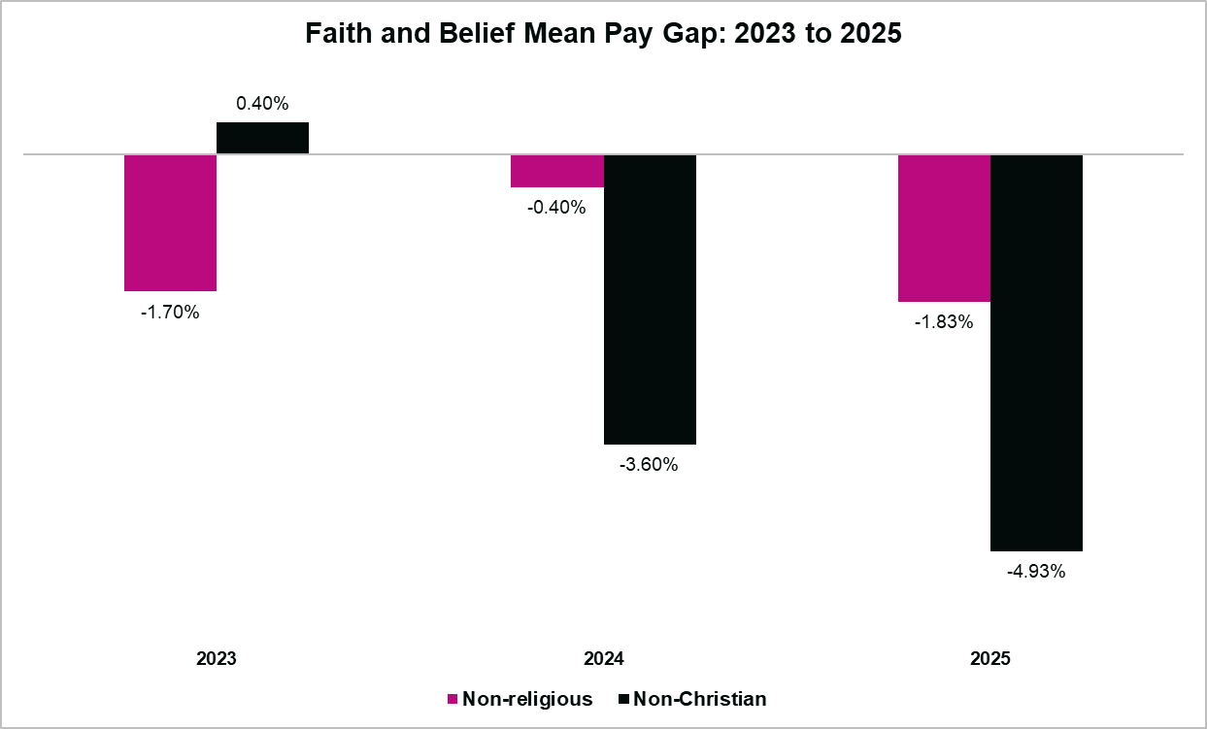
FAITH AND BELIEF Pay Gap
Our data shows that 43% of employees are Non-religious, 34% are Christian, 15% Preferred Not to Say and 7% follow a Non-Christian Faith/Belief..
This measure looks at the Pay Gap between those who declare they’re Non-Christian or Non-Religious compared to those who declare a Christian religion. We use this comparison because it aligns with Census 2021 data which identified Christian as the majority religion in England and Wales.
Faith and Belief Median and Mean earnings
In the chart below a negative figure shows an inverse pay gap, which means it favours Non-religious or Non-Christian, as they earn more than Christians.
The Median shows a change for Non-religious and Non-Christians, both now earning 0.20% less than Christians. This shows a narrowing of the pay gap.
At the Mean, the pay gap favours both Non-religious and Non-Christian groups, widening the gap since April 2024.

Slide 15
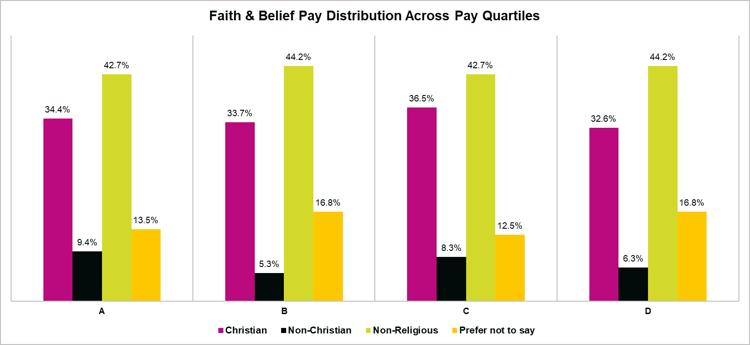
FAITH AND BELIEF Pay Gap
Faith and Belief Pay Quartiles
The balance of Faiths and Beliefs across pay quartiles is reasonably consistent.
(Band A = lowest pay quartile; Band D = highest pay quartile)
Faith and Belief Further Analysis
Of those who took on new positions, redeployments, or who had changes to pay in the year, 3.57% were Non-Christian (who make up 7% of the workforce) and 46.42% were Non-religious (who make up 43% of the workforce).

Slide 16
Actions we are taking in support of addressing our pay gaps
We recognise that our median gender pay gap has widened this year and remain committed to understanding the drivers behind this change and taking sustained action to address inequality. We will undertake a more detailed analysis of our gender pay gap, including reviewing pay by role, level, and function, to identify any specific areas of disparity and inform targeted actions.
Policy and governance We are regularly reviewing our employment policies and conducting equity impact assessments to ensure they do not disadvantage colleagues with protected characteristics, and we are strengthening them with clear sections on reasonable adjustments. We have recently reviewed our progress against our DEIB Strategy and now have a focussed Action Plan to work towards in 2026. Our Flexible Working and Menopause policies have also recently been reviewed and updated.
Inclusive recruitment and progression We continue to strengthen our inclusive recruitment practices to attract a diverse range of applicants. This includes using inclusive language, advertising salary ranges (#ShowTheSalary), removing unnecessary qualification requirements, and offering flexibility where possible. We also use anonymised screening and structured interview processes to reduce bias.
Fair pay and reward
We are committed to being a Real Living Wage employer, ensuring all colleagues are paid a wage that reflects the cost of living. This forms part of our broader approach to fair and equitable pay across the organisation.
Data and insight We are strengthening our data and insight to better understand the drivers behind our gender pay gap. This includes developing our understanding of diversity data for agency workers and internal movers, where current data is limited, to support more informed analysis and targeted action.
Inclusive culture and leadership We are embedding inclusive leadership through The Young Lives Way - the framework that translates our Values into behaviours - ensuring equity and inclusion are reflected in everyday behaviours and decision-making. We continue to build organisational awareness and capability through initiatives such as the training we run with the Social Justice and Change organisation, and our trauma-informed and DEIB engagement campaigns, supporting colleagues to recognise and challenge inequity and create an inclusive, supportive culture.
Flexible and accessible ways of working We remain committed to providing progressive and flexible working arrangements across all levels of the organisation, supporting equitable access to career development opportunities.

